Slide 1
Using Persistent Data Structures for Adding Range Restrictions to Searching Problems
Hans-Peter Lenhof and Michiel Smid
RAIRO Theoretical Informatics and Applications, Vol. 28, pp. 25-49, 1994
Presenter: Chiou-Ting Tseng
Date: Feb. 3, 2009

Slide 2
Partially persistent data structure
可以query在時間T時該data structure的狀態，可以更改current version的值
在RAM model之下，對每個位址都放一個vEB tree以更新的時間當作key，更新的值當作value
我們要查某個位址在時間T的內容就是去該位址的vEB tree問key比T小最大的所帶的value是多少

Slide 3
Problem Definition
給N個2D點，找[a, a+d][b, INF]中第二個dimension最小的。

Slide 4
Randomized van Emde Boas Tree
Store m integers in [1…n]
O(m) space
Predecessor: O(loglogn) time
Max: O(1) time
Insert: O(1) time
Make use of the stratified tree.

Slide 5
Bounded Ordered Dictionaries in O(log log n) Time and O(n) Space
K. Mehlhorn and S. Näher
Information Processing Letters, Vol. 35, pp. 183–189, 1990

Slide 6
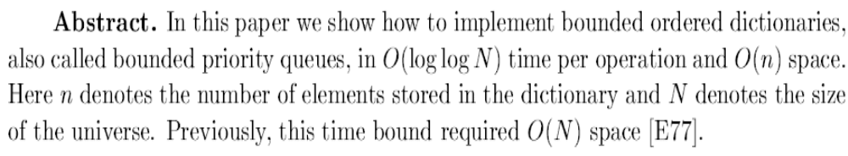
Abstract

Slide 7
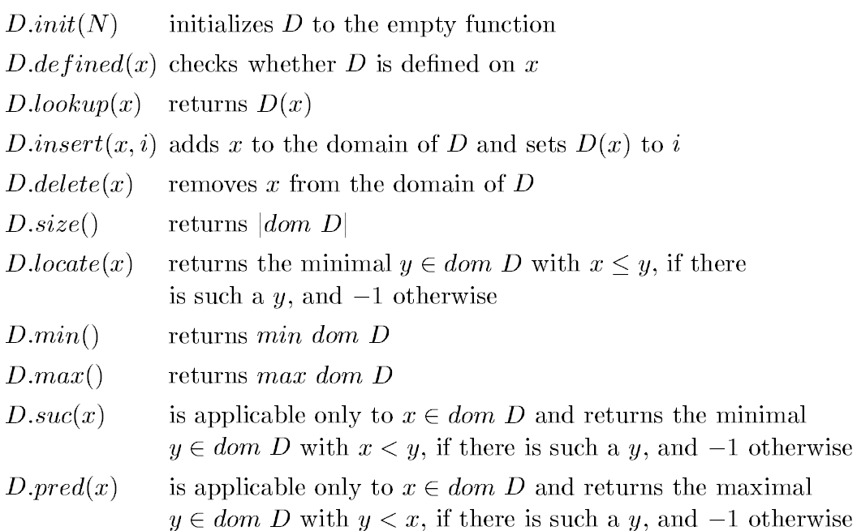
Operations

Slide 8
Bounded Dictionary
(1, apple), (4, orange), (3, banana), (6,grape)
Hash: 1->2, 4->3, 3->4, 6->1
(6,grape) | (1, apple) | (4, orange) | (3, banana)

Slide 9
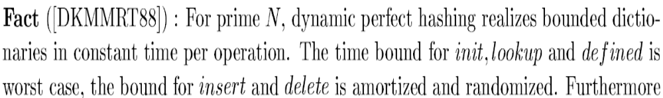
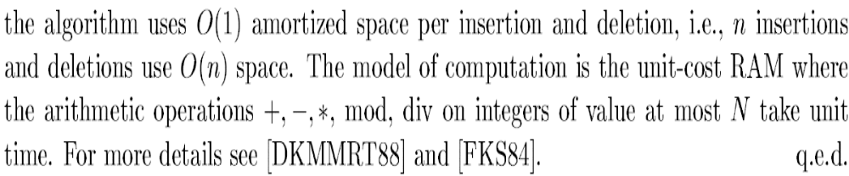
Bounded Dictionary
Support init, insert, delete, lookup, defined
因為能夠做perfect hashing, insert/delete就是把h(x)的位置改成1/0
Initialize O(1) time是因為一開始只用一格, 每當space變兩倍就重新hashing後重存
所以時間是每logn個input花2logn, amortize O(1) time

Slide 10
Stratified tree
假設有n個數，值是[0, N-1] 。
我們需要space O(nloglogN)的 Stratified tree來記錄。
在這棵tree中找某個數字O(loglogN) time。
Max element O(1) time。
Insert O(loglogN) time。
Initialize O(1) time。

Slide 11
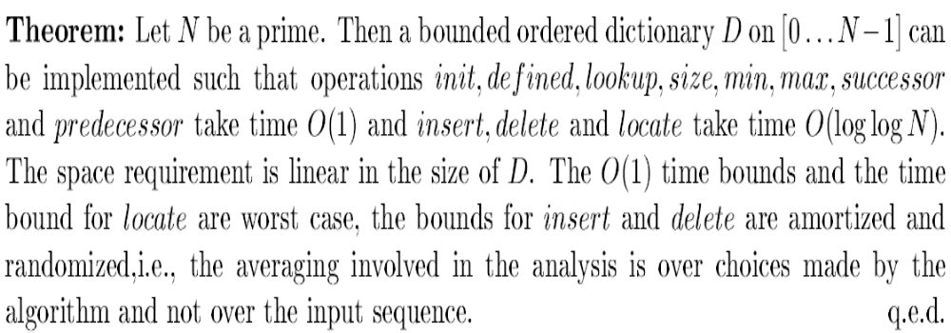
Bounded Ordered Dictionary
A bounded ordered dictionary D on [0…N-1] is a partial function from [0…N-1] to some set I, called the information type of D

Slide 12
Bounded Ordered Dictionary
Elements (6,100) , (1, 104), (4, 210
List A: (1, 104)→(4, 210)→(6,100)
6 | 1 |  | 4
Hash
1 |  |  | 4 |  | 6

Slide 13
Bounded Ordered Dictionary
Elements (6,100) , (1, 104), (4, 210), (3, 115)
List A: (1, 104)→(3, 115)→(4, 210)→(6,100)
6 | 1 | 3 | 4
Hash
1 |  | 3 | 4 |  | 6

Slide 14
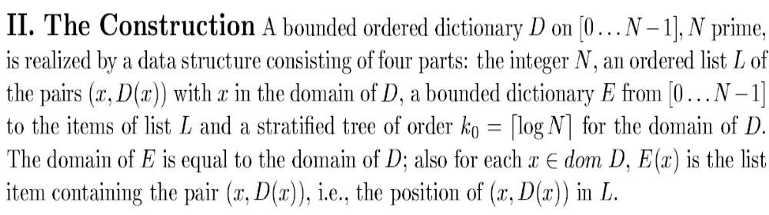
Bounded Ordered Dictionary
Support init, insert, delete, lookup, defined,
size, locate, min, max, suc, pred
上一頁已經說init, insert, delete, lookup, defined可以在O(1)內
由bounded dictionary做到，下面只討論用straitified tree做
size, locate, min, max, suc, pred

Slide 15
Defined, Lookup, Suc, Pred
It is clear that using the ordered list L, and the bounded directory E the operations defined(), lookup(), suc(), pred() take constant time. Also, initialization, insertion, and deletion takes expected constant time when restricted to those componemts.
The stratified tree of order k₀ is used to support the locate operation on the domain of D.

Slide 16
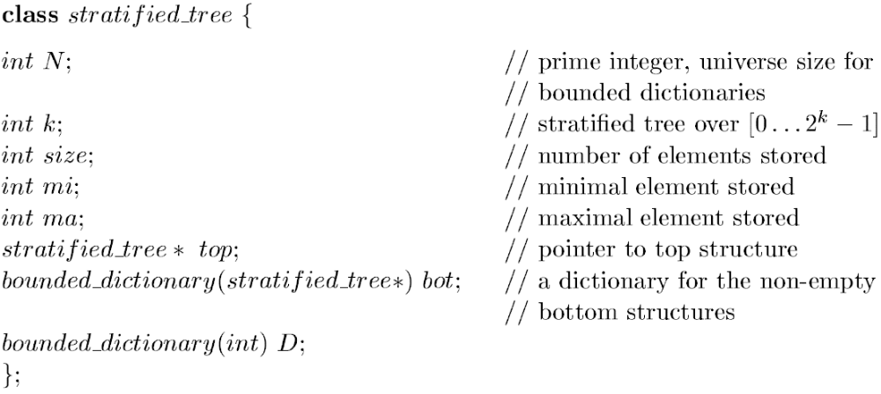
Stratified tree
Consists of 值的範圍, bit數, set大小, set中最小值, set中最大值, 指向upper half bits形成的tree的pointer, lower half bit紀錄upper half bit形成的tree的record

Slide 17
Example
Element=10,11
T1
T2
Min=10
Max=11
Size=2
D={10, 11}
Top=T1
Bot={(2, T2)}
k=2
Min=2
Max=2
Size=1
D={2}
Top=NIL
Bot=NIL
k=1
Min=2
Max=3
Size=2
D={2,3}
Top=NIL
Bot=NIL
k=1

Slide 18
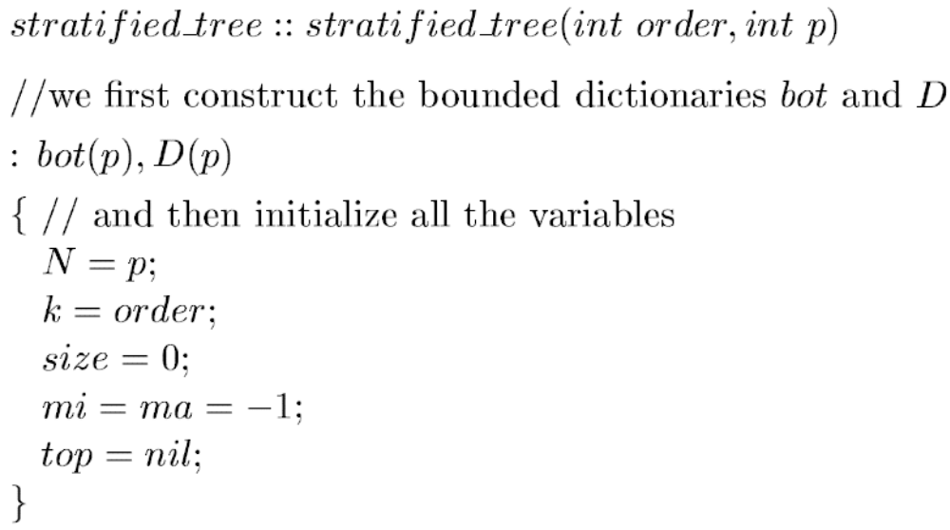
Initialize

Slide 19
Insert - 1
假設插入x, x=x1x2
k=1 or size=0, we update field min, max, size, D.
O(1) time
We only consider k>1, size>=1 in the following pages.

Slide 20
Insert - 2
size=1, 只有一個元素, 假設是y, y=y1y2
Case 2.1, y1!=x1,如已經有10, 插入3
Case 2.2, y1=x1, 如已經有10, 插入11
Min=10
Max=10
Size=1
D={10}
Top=NIL
Bot=NIL
k=2

Slide 21
Insert - 2.1
已經有10=(22)₄, 插入3=(03)₄
T1
T2
T3
Min=3
Max=10
Size=2
D={10, 3}
Top=T1
Bot={(0, T2)
(2, T3)}
k=2
Min=0
Max=2
Size=2
D={0, 2}
Top=NIL
Bot=NIL
k=1
Min=3
Max=3
Size=1
D={3}
Top=NIL
Bot=NIL
k=1
Min=10
Max=10
Size=1
D={10}
Top=NIL
Bot=NIL
k=2
Min=2
Max=2
Size=1
D={2}
Top=NIL
Bot=NIL
k=1

Slide 22
Insert - 2.2
已經有10=(22)₄, 插入11=(23)₄
T1
T2
Min=10
Max=10
Size=1
D={10}
Top=NIL
Bot=NIL
k=2
Min=10
Max=11
Size=2
D={10, 11}
Top=T1
Bot={(2, T2)}
k=2
Min=2
Max=2
Size=1
D={2}
Top=NIL
Bot=NIL
k=1
Min=2
Max=3
Size=2
D={2,3}
Top=NIL
Bot=NIL
k=1

Slide 23
Insert - 3
Finally, if size ≥ 2 we insert x1 into the top structure. Also, if x1∉S’ then we create a stratified tree T1 of order ⎡k/2⎤, insert x2 into T1 and (x2, pointer to T1) into bot. If x1∈S’ then we only insert x2 into the tree bot(x1). We conclude as above that in either case only one of the two recursive calls insert is non-trival. Thus running time is O(logk).

Slide 24
Delete - 2.1
刪除11=(23)₄
T1
T2
Min=10
Max=11
Size=2
D={10, 11}
Top=T1
Bot={(2, T2)}
k=2
Min=2
Max=2
Size=1
D={2}
Top=NIL
Bot=NIL
k=1
Min=2
Max=3
Size=2
D={2,3}
Top=NIL
Bot=NIL
k=1
Min=10
Max=10
Size=1
D={10}
Top=NIL
Bot=NIL
k=1

Slide 25
Delete - 2.2
刪除3=(03)₄
T1
T2
T3
Min=3
Max=11
Size=3
D={10, 11, 3}
Top=T1
Bot={(0, T2)
(2, T3)}
k=2
Min=0
Max=2
Size=2
D={0, 2}
Top=NIL
Bot=NIL
k=1
Min=3
Max=3
Size=1
D={3}
Top=NIL
Bot=NIL
k=1
Min=2
Max=3
Size=2
D={2,3}
Top=NIL
Bot=NIL
k=1
T1
T2
Min=10
Max=11
Size=2
D={10, 11}
Top=T1
Bot={(2, T2)}
k=2
Min=2
Max=2
Size=1
D={2}
Top=NIL
Bot=NIL
k=1
Min=2
Max=3
Size=2
D={2,3}
Top=NIL
Bot=NIL
k=1

Slide 26
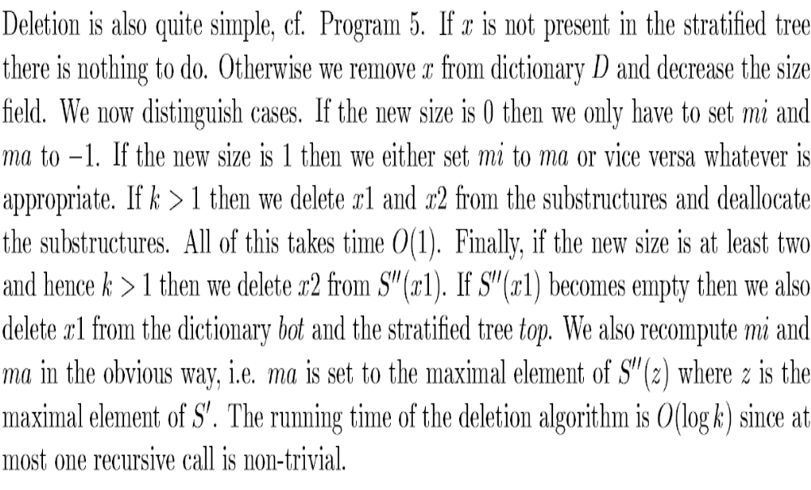
Delete

Slide 27
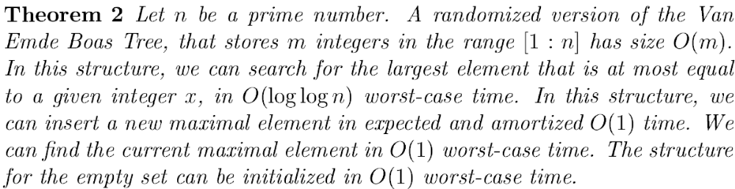
Randomized vEB tree

Slide 28
Randomized vEB tree
We insert elements in increasing order.
把這m個數分成size是loglogn的bucket，並滿足第i個bucket裡的數比第i+1個bucket小
把每個bucket的最小的element放到stratified tree.
Successor: Search for the bucket in the stratified tree O(loglogn) time. Linear search in the bucket O(loglogn) time.
Insert: Find the bucket storing the largest element O(1) time. Insert the new element in this bucket, if the bucket becomes 2loglogn, split it. Amotize O(1) per insertion.
Max: Maintain sepatately.

Slide 29
Making Data Structures Persistent

Slide 30
Making data structures persistent (DSST 89)
We will show a general technique to make data structures partially and later fully persistent.
The time penalty of the transformation would be O(1) per elementary access and update step.
The space penalty of the transformation would be O(1) per update step.
In particular, this would give us an O(n) space solution to the planar point location problem

Slide 31
Partial persistence
Several constructions to make various data structures persistent have been devised, but no general approach has been taken until the seminal paper by Driscoll, Sarnak, Sleator and Tarjan, 1986.
Specification of a linked data structure
Finite collection of nodes with a fixed number of fields
Access is provided by a number of access pointers

Slide 32
Fat node method – partial persistence
Applies to any linked data structure
Each fat node contains same fields as ephemeral node and a version stamp
Each field in a node contains a list of version-value pairs
Each original field has same version stamp as node itself

Slide 33
Fat node method – partial persistence
Modifications
Ephemeral update step i creates new node: create a new fat node with version stamp i and original field values
Ephemeral update step i changes a field: store the field value plus a timestamp
Each node knows what its value was at any previous point in time

Slide 34
Fat node method – partial persistence
Access field f of version i:
Choose the value with maximum version stamp no greater than i
Time cost per access and update step
If values of a field are ordered by version stamp and stored in a BST:
Logarithmic time overhead in the times of access and update operations over the ephemeral structure
Space cost
O(1) space per update step

Slide 35
The fat node method (Cont.)
Simulation of an update step when producing version i:
NULL
4
5
When a new node is created by the ephemeral update we create a new node, each value of a field in the new node is marked with version i.
7
15
When we change a value of a field f to v, we add an entry to the list of f with key i and value v

Slide 36
The fat node method (Cont.)
Simulation of an access step when navigating in version i:
NULL
4
5
The relevant value is the one tagged with the largest version number smaller than i
7
15

Slide 37
Partialy persistent deques via the fat node method
1
x
1
V1
Null
Null
Null
1
1
x
2
y
2
Null
V2 = inject(y,V1)
Null
2
Null
1
1
x
2
y
2
Null
V3 = eject(V2)
Null
3
2
Null
Null
1
1
x
2
y
2
Null
V4= inject(z,V3)
Null
3
2
4
Null
4
z
4
Null

Slide 38
Path copying method – partial persistence
Make a copy of the node before changing it to point to the new child. Cascade the change back until root is reached
Making a modication creates a new root
version 1
version 1
version 2
17
Insert 25
17
17
10
23
10
23
23
25

Slide 39
Path copying method – partial persistence
Access version i:
Maintain an array of roots indexed by timestamp
If update times are consecutive integers:
O(1) time access into the root array
O(log n) total time for an access operation (for balanced trees)
Major drawback: space cost

Slide 40
Node copying method – partial persistence
Only a limited number of extra values allowed
If there is no more space, create a new copy which contains only the newest value of each field
Nodes have a fixed number of fields:
version stamp
key
original fields
copy pointer
extra pointers (each has a field name and a version stamp)
predecessor pointers

Slide 41
Node copying method – partial persistence
Each node contains only one version of each information field
Each ephemeral node corresponds to a set of persistent nodes (family)
Each such family forms a singly linked list, linked by copy pointers (increasing order by version stamp)
The newest member is last on the list
The last nodes and their newest field values represent the newest version of the ephemeral structure

Slide 42
Node copying method – partial persistence
Modifiy information field f of node x
create new node y and make copy pointer of x point to y
store most recent values of each field in y
update predecessors to point to y (this sequence of node copying may cascade)

Slide 43
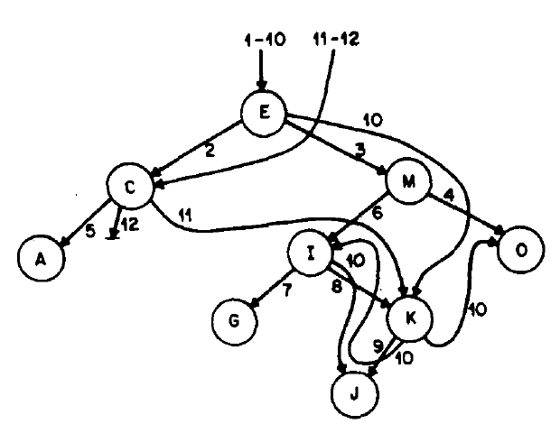
Example

Slide 44
Node copying method – partial persistence
An example, applied to binary search trees
4
-------------
lft rt
4
-------------
lft rt
4
-------------
lft rt 1:lft
Insert 1
at time 0
Insert 3
at time 1
2
-------------
lft rt
2
-------------
lft rt 0:lft
2
-------------
lft rt 0:lft
2
-------------
lft rt
1
-------------
lft rt
1
-------------
lft rt
3
-------------
lft rt

Slide 45
Insert into persistent 2-4 trees with node copying
2
1
. . . . . . .
. . . . . . . .
1
3
. .
12
14
18
20
21
28
12
14
16
18
20
21
28
29

Slide 46
Node copying method – partial persistence
Modifiy pointer field f of node x
1. If there is an empty extra field:
assign new value to it
f points to a node z: update corresponding predecessor pointer in z to point to x
2. All extra fields are used:
create new node y and make copy pointer of x point to y
store most recent values of each field in y
update predecessors to point to y (this sequence of node copying may cascade)
f points to a node z: update corresponding predecessor pointer in z to point to y

Slide 47
Node copying method – partial persistence
Modifiy pointer field f of node x
2. All extra fields are used:
p1
p1
c
p2
p1
c
p2
Cascade change back through ancestors
x
c
y
f
z

Slide 48
Node copying method – partial persistence
Searching in version j
Follow an entry pointer with largest version number i, i <= j
Compare keys and follow newest pointer no greater than j
Access time
If update times are consecutive integers:
O(1) time access into the root array
Access time gets an O(1) slow-down over the ephemeral structure (check modification box on each accessed node)

Slide 49
Node copying method – partial persistence
Node copying, applied to binary search trees
A major simplification is possible:
One can dispense with
Inverse pointers (there is only one access path to any node- a node is only accessed after all its predecessors are accessed)
Copy pointers and version stamps of nodes (since any version will be up-to-date for node copying goes back through all ancestors)

Slide 50
Node copying method – partial persistence
An example, applied to binary search trees
4
-------------
lft rt
4
-------------
lft rt
4
-------------
lft rt 1:lft
Insert 1
at time 0
Insert 3
at time 1
2
-------------
lft rt
2
-------------
lft rt 0:lft
2
-------------
lft rt 0:lft
2
-------------
lft rt
1
-------------
lft rt
1
-------------
lft rt
3
-------------
lft rt

Slide 51
Insert into persistent 2-4 trees with node copying
. . . . . . .
. . . . . . . .
1
3
. .
12
14
18
20
21
28
16

Slide 52
Insert into persistent 2-4 trees with node copying
1
. . . . . . .
. . . . . . . .
1
3
. .
12
14
18
20
21
28
12
14
16
18

Slide 53
Insert into persistent 2-4 trees with node copying
1
. . . . . . .
. . . . . . . .
1
3
. .
12
14
18
20
21
28
29
12
14
16
18

Slide 54
Insert into persistent 2-4 trees with node copying
1
. . . . . . .
. . . . . . . .
1
3
. .
12
14
18
20
21
28
12
14
16
18
20
21
28
29

Slide 55
Insert into persistent 2-4 trees with node copying
2
1
. . . . . . .
. . . . . . . .
1
3
. .
12
14
18
20
21
28
12
14
16
18
20
21
28
29

Slide 56
Node copying method – partial persistence
Time and space cost for modifications
A modification takes O(1) amortized space and O(1) amortized time (using the potential technique)

Slide 57
Node copying method – partial persistence
Potential technique
The potential is a function of the entire data structure
Definition potential function: A measure of a data structure whose change after an operation corresponds to the time cost of the operation
The initial potential has to be equal to zero and non-negative for all versions
The amortized cost of an operation is the actual cost plus the change in potential
Different potential functions lead to different amortized bounds

Slide 58
Node copying method – partial persistence
Definitions
Live nodes: reachable from the root of the most recent version (they form the latest version), dead otherwise
Full live nodes: live nodes whose modification boxes are full

Slide 59
Node copying method – partial persistence
Potential technique
The potential function f(T): the number of full live nodes in T
(initially zero)
Each modification involves k number of copies, each with a O(1) space and time cost, and one change to a modification box with O(1) time cost

Slide 60
Node copying method – partial persistence
The amortized cost of an operation is the actual cost plus the change in potential
Change in potential after update operation i: Δ f = 1 - k
(1: each update involves one change to a modification box
k: # of full live nodes that get copied, copies have their modification box empty)
Amortized cost: k + Δ f
A modification takes O(1) amortized space and O(1) amortized time

Slide 61
Node copying method – partial persistence
Boroujerdi and Moret improved this result getting a worst case (instead of amortized) time and space cost of O(1) per update step
Technique: Delayed node copying
Copy only a constant number of nodes per update step
Copy the remaining nodes later as time permits

